Slide 1
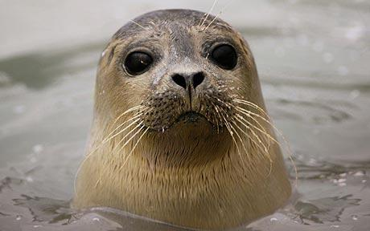
Write down and answer these problems on page 37, show all your work (will be checked for HW grade).
1- In seals, the gene for long whiskers has two alleles. Dominant allele (W) is for long whiskers & the recessive allele (w) codes for short whiskers. Calculate the % of offspring that will have long whiskers when a homozygous dominant and a heterozygous seal cross?
2- If one parent is pure long whiskers (homozygous dominant) and the other is short-whiskered, what % of the offspring will have short whiskers?
* Problems #26 & 27 from textbook page 59.

